Slide 1

UNIVERSITY OF BUEA FACULTY OF ENGINEERING AND TECHNOLOGY DEPARTMENT OF COMPUTER ENGINEERING LEVEL 300
Group 1: lA Squad
SOFTWARE DEVELOPMENT TOOLS CEF 333
GROUP 1
DEMONSTRATING GROUP COLLABORATION VIA GITHUB, SHOWING COMMITS, BRANCHES AND PULL REQUEST WORKFLOWS
S/N | GROUP MEMBER | MATRICULATION NUMBER
1. | LENYA SHAMPEL LENYA | FE23A001
2. | ABON | FE23A002
3. | ACHUO PLACID ACHUO-ASSAM | FE23A004
4. | AFUH CHIKE CHEWAKONDI | FE23A005
5. | AKOH JUNIOR NGOH | FE23A008
COURSE FACILITATOR: DR. NKEMENI Valery

Slide 2
Git
Git is a version control system.
It permits collaborators on a certain project to
Have a local copy of the remote project repository;
Add features independently without altering the main codebase through branching and
Track and navigate between changes made to a repository

Slide 3
GitHub
This is the web based platform where we host a remote (online repository).
It , uniquely,
Enables code sharing and
Offers the online and GUI version of some services that Git offers like creating a repository, merging…

Slide 4
To use Git , we commonly use git commands

Slide 5
Common Git commands used when collaborating

Slide 6
Command: git clone <repository-url>
Use: Make a local copy of the remote repository so you can work on the project locally
Command: git status
Show changes which are staged, upstaged or untracked

Slide 7
Making changes and pushing
Command: git add .
Stage files for git to track their changes
Git commit –m “Your commit message”
Commit the changes with a message, save changes as historical version
git push origin main
Push the changes to main

Slide 8
Branching, Merging and Pulling
Command: git branch <branch-name>
Creates a branch, allows you to work on features and fixing without affecting the main codebase
Command: git switch <branch-name>
Switch to work on another branch
Command: git merge <branch-name>
Merge changes of another branch into the main branch

Slide 9
Command: git pull origin <branch-name>
Intergrates the changes from the remote repository into your current branch, updating your local copy

Slide 10
Since we had already created a repository, we will use it to demonstrate how a group member, Lenya Shampel collaborated on this repository

Slide 11
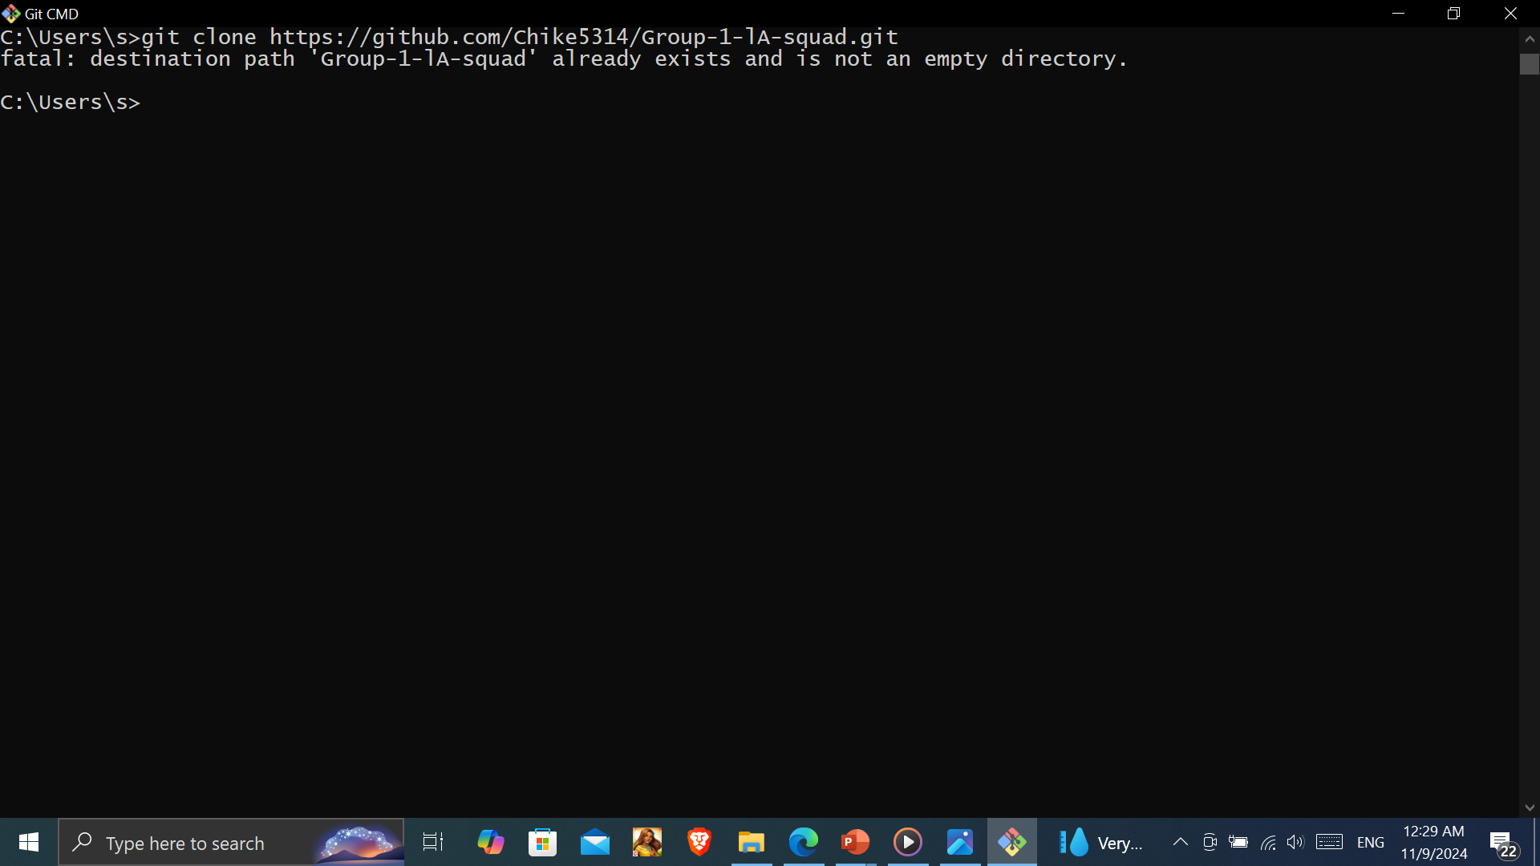
Collaboration procedures
Lenya cloned

Slide 12
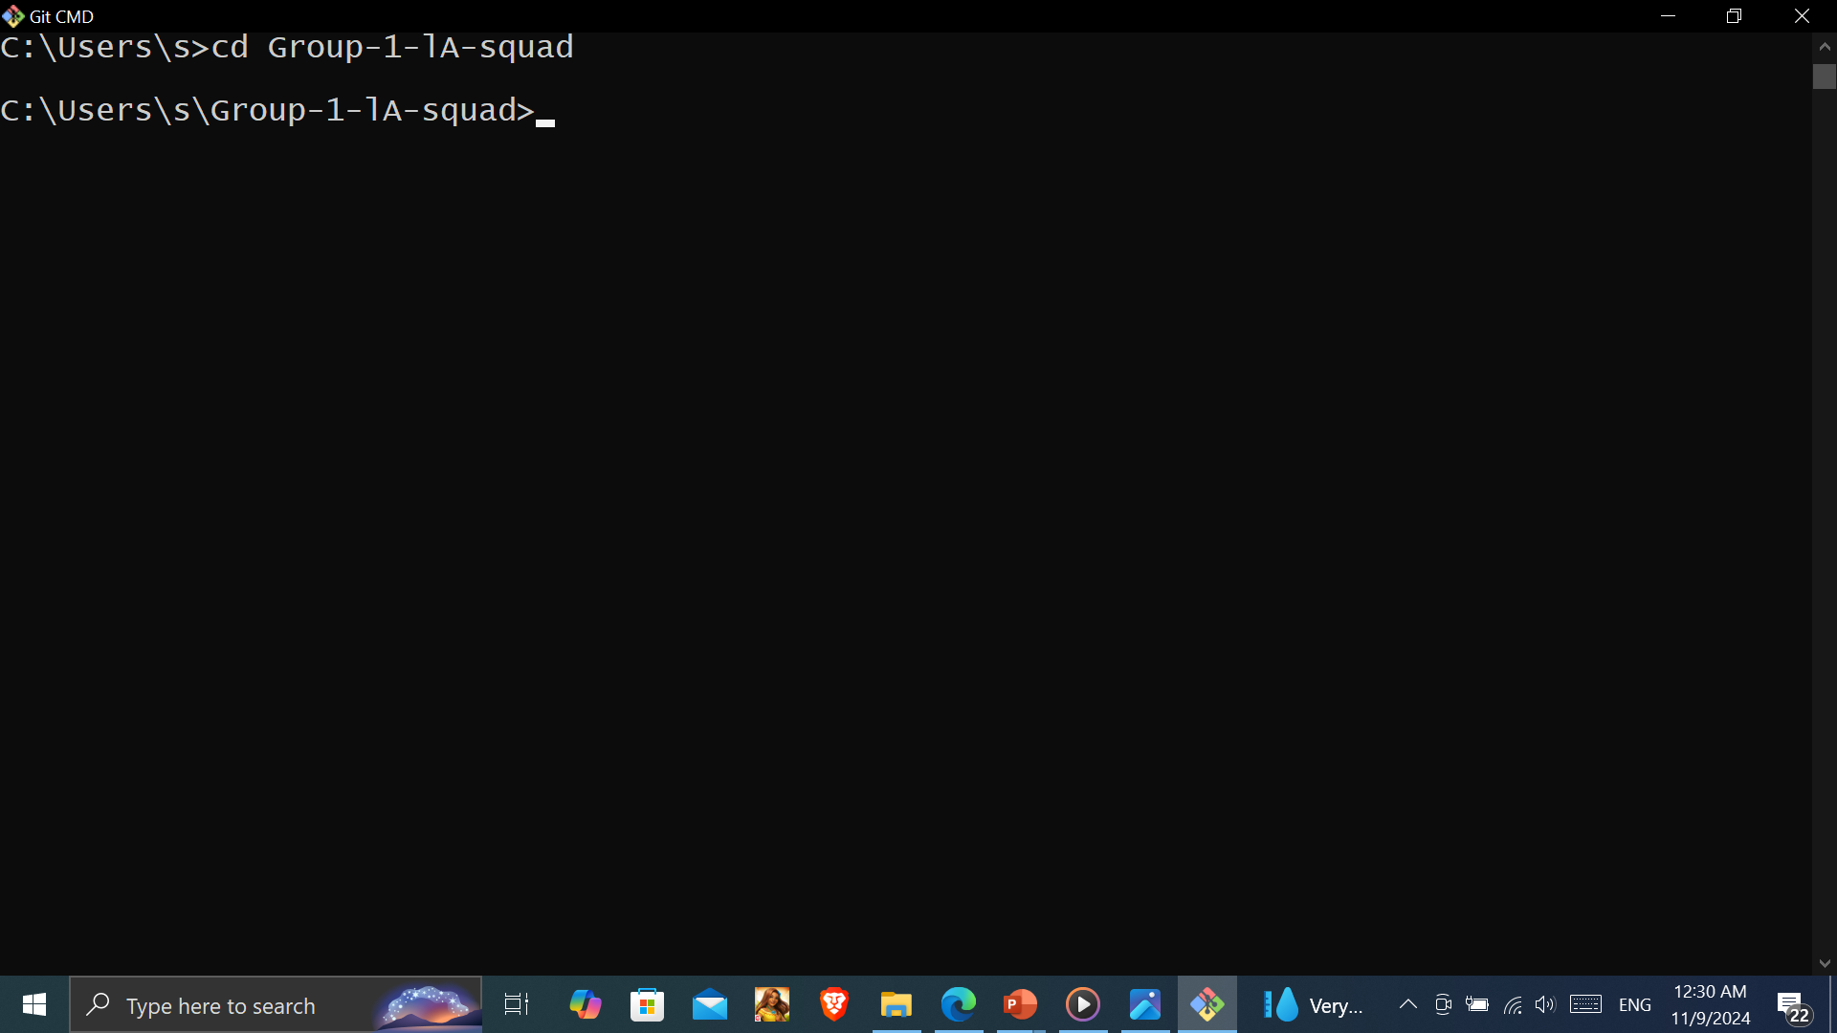
Navigated to the repository

Slide 13
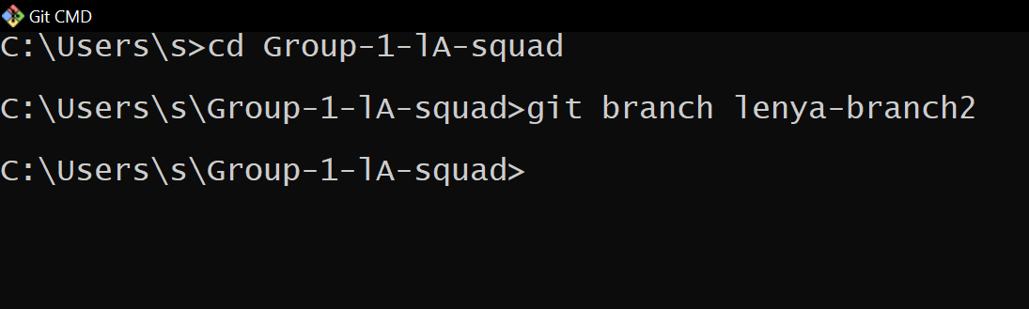
created a branch

Slide 14
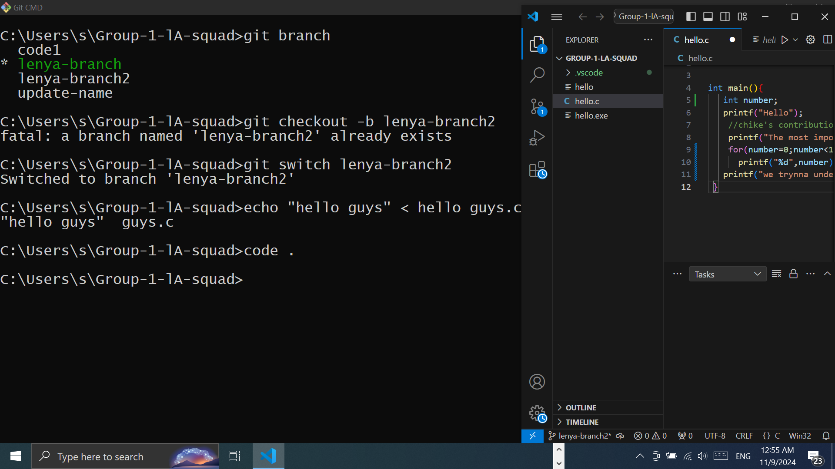
Created a new file in the branch, edited it (collaborated)

Slide 15
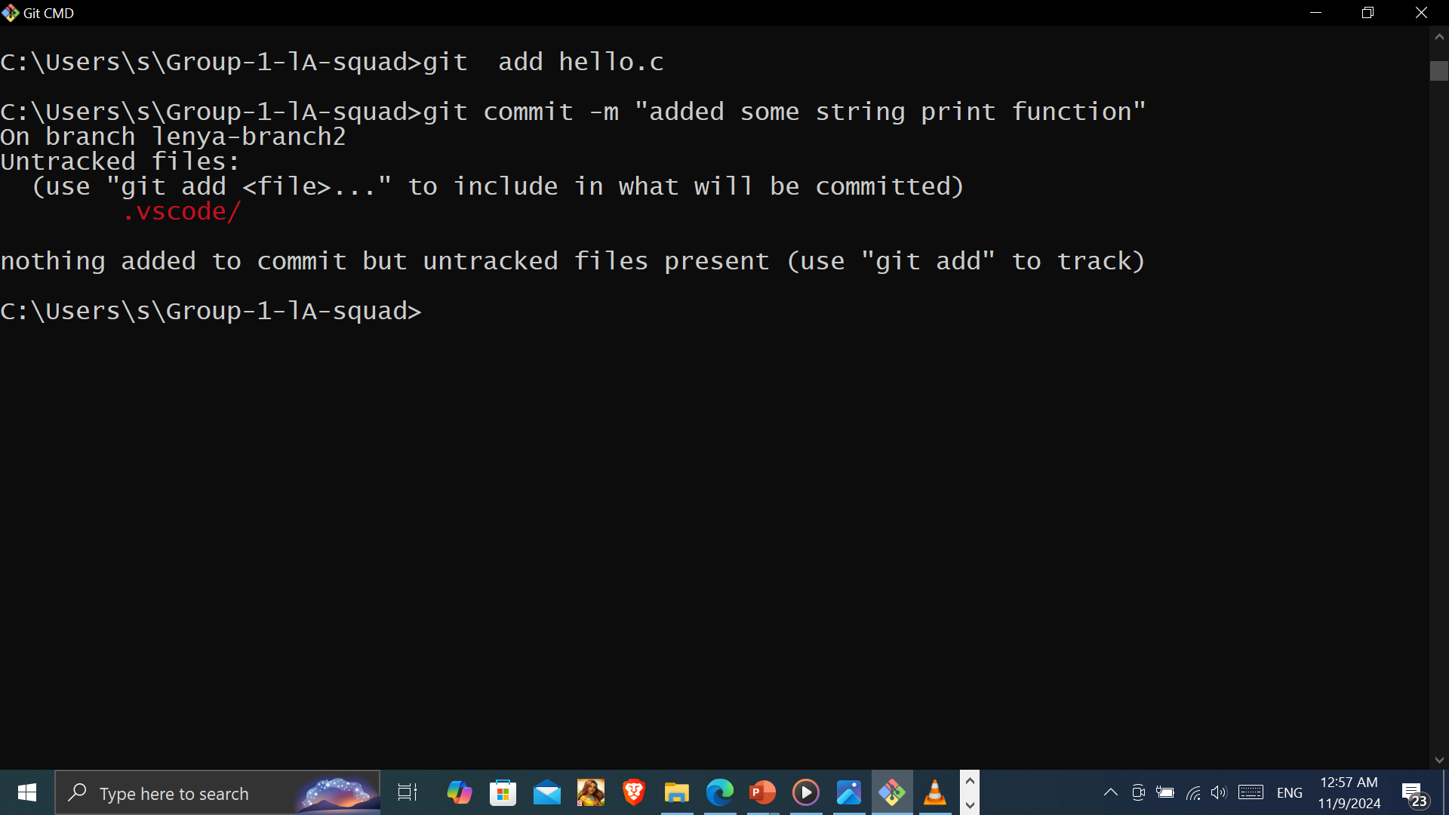
Added the file to the staging area, committed the file with the message “most important contribution” and finally pushed it to the GitHub repository

Slide 16
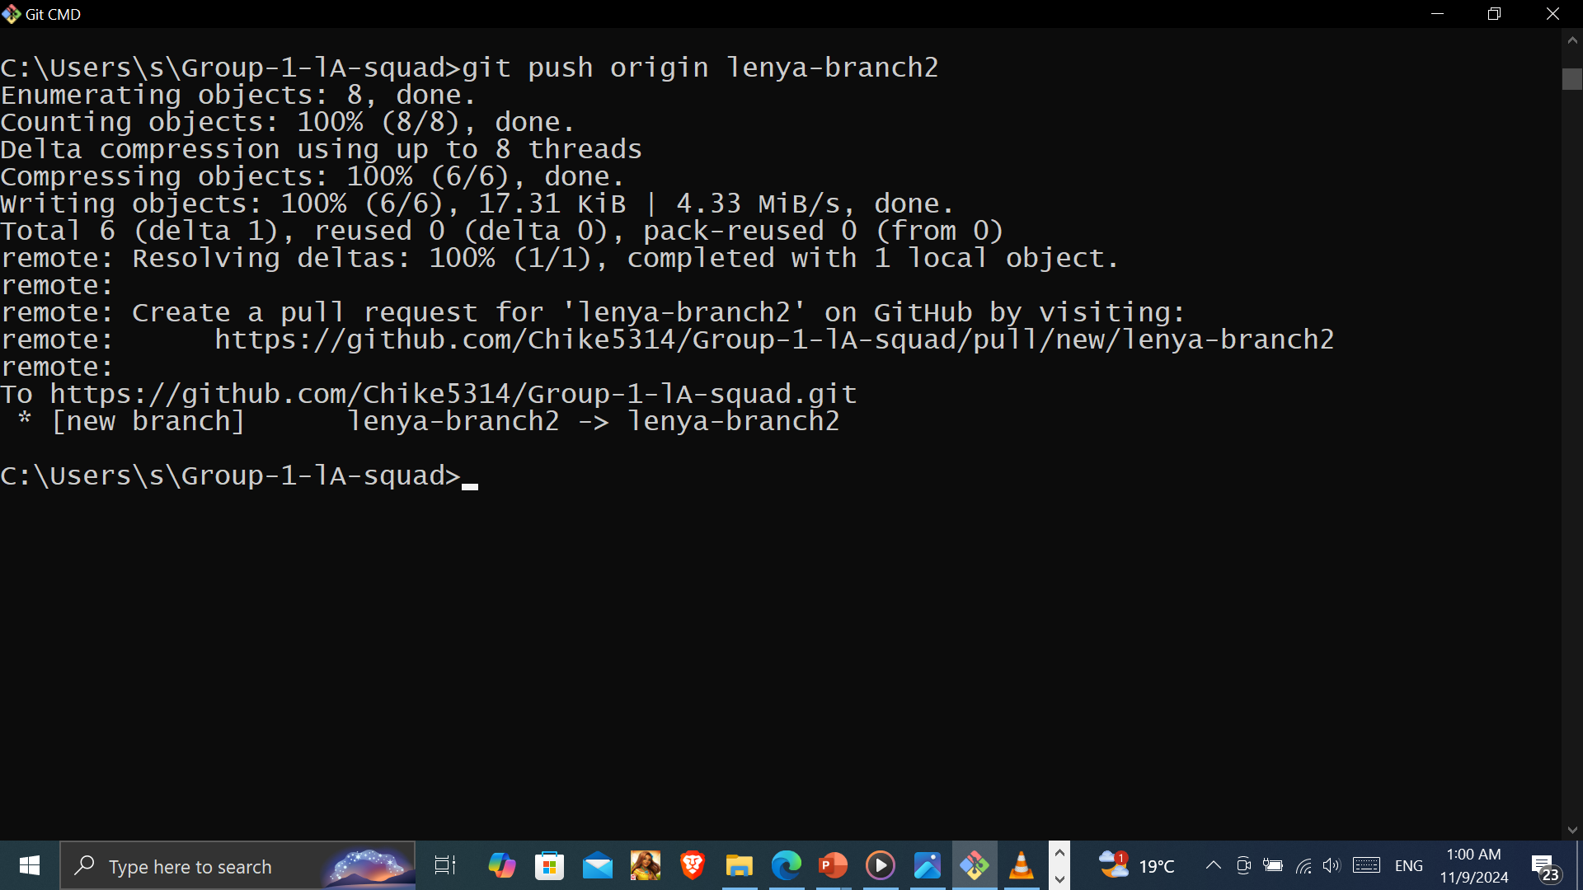

Slide 17
Pull request, code reviews and merging on Github
When the branch is pushed, it creates a pull request, which is requesting for merging of the pushed code to the main branch
The code can then be reviewed by the administrator, the creator, who can comment, discuss any issues with the author directly
Once it is approved, it can then be merged.

Slide 18
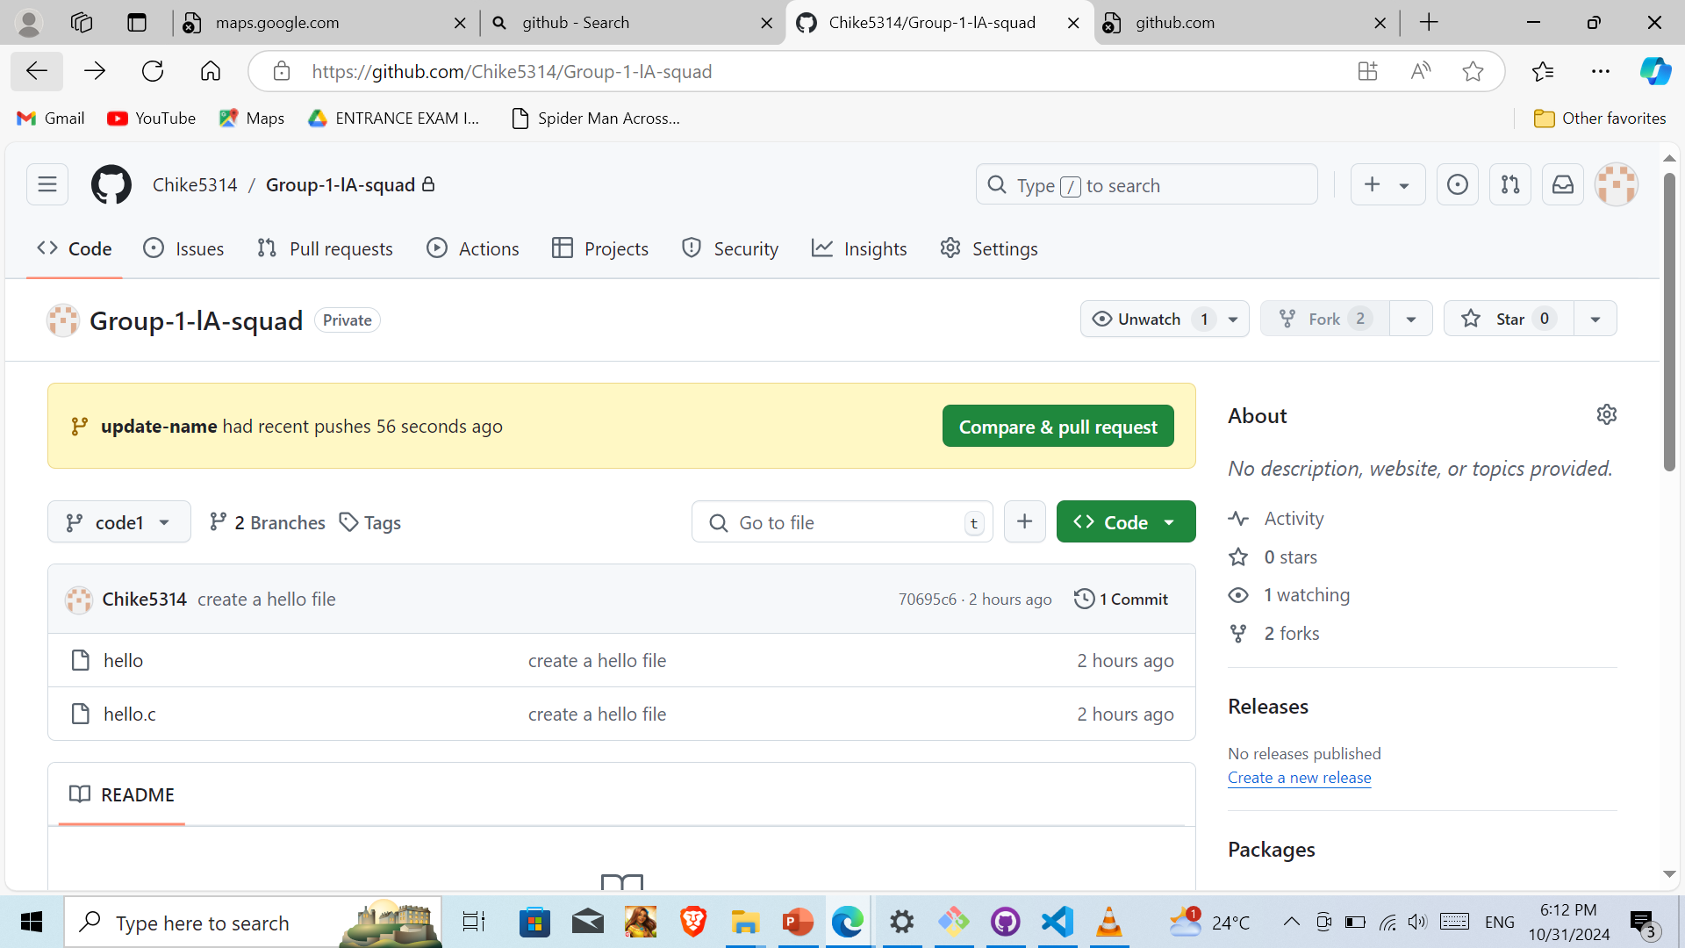
Pull request appears on GitHub repository

Slide 19
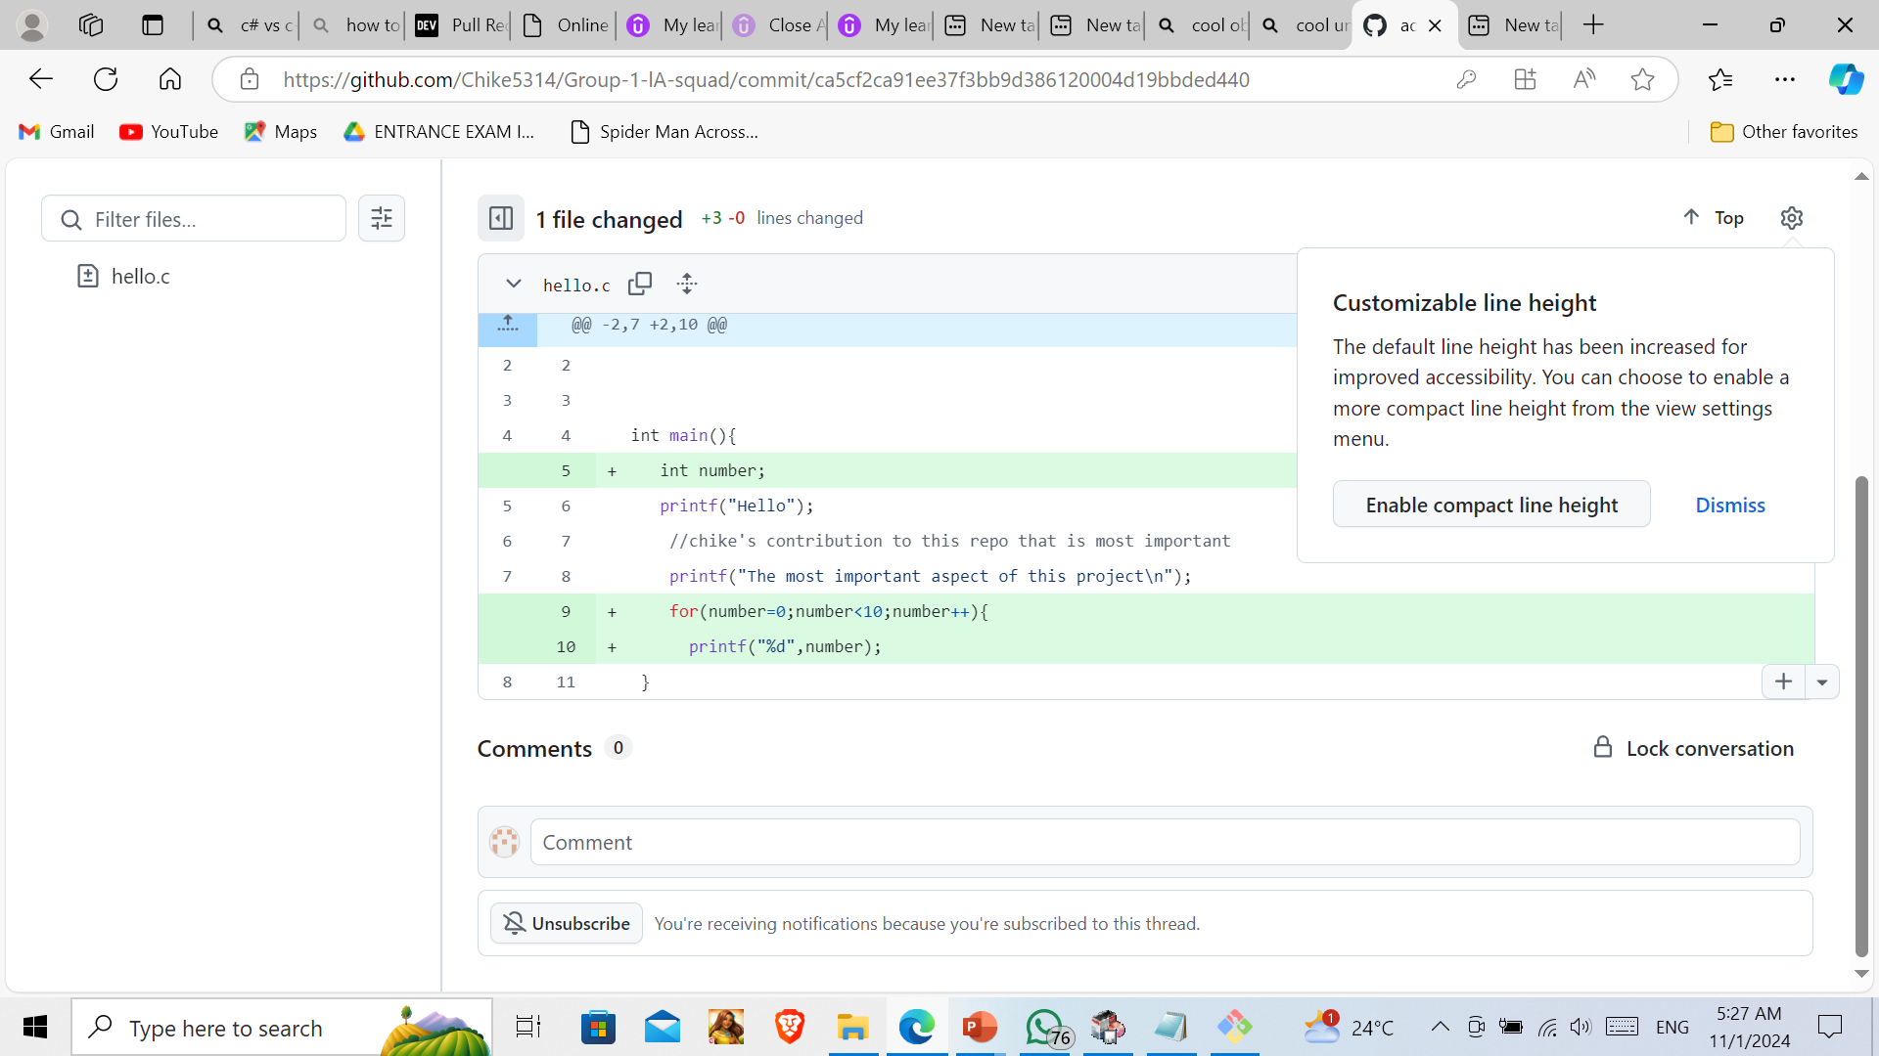
Code is reviewed

Slide 20
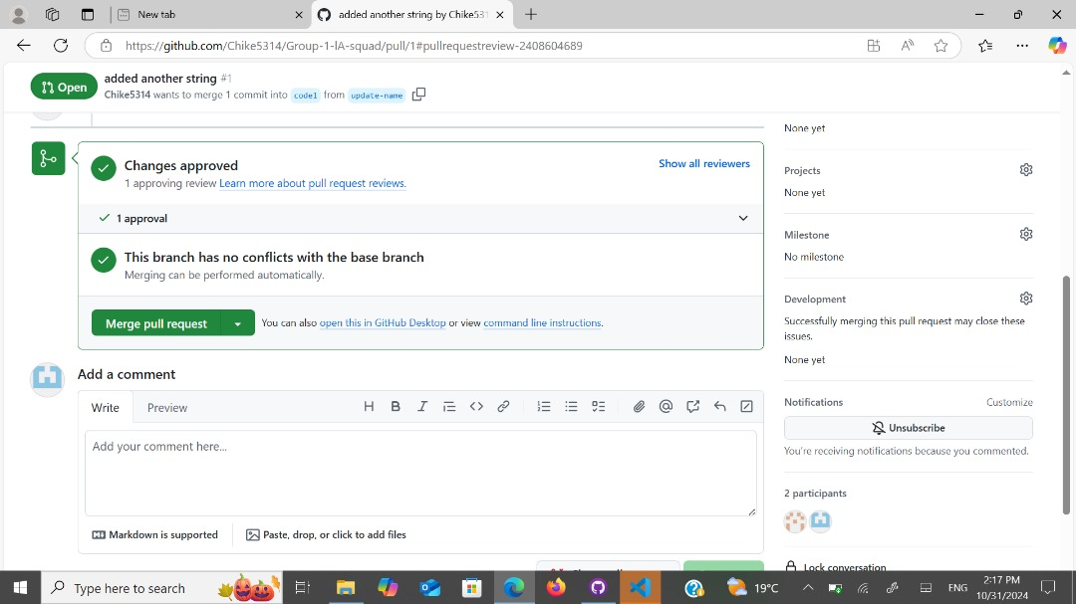
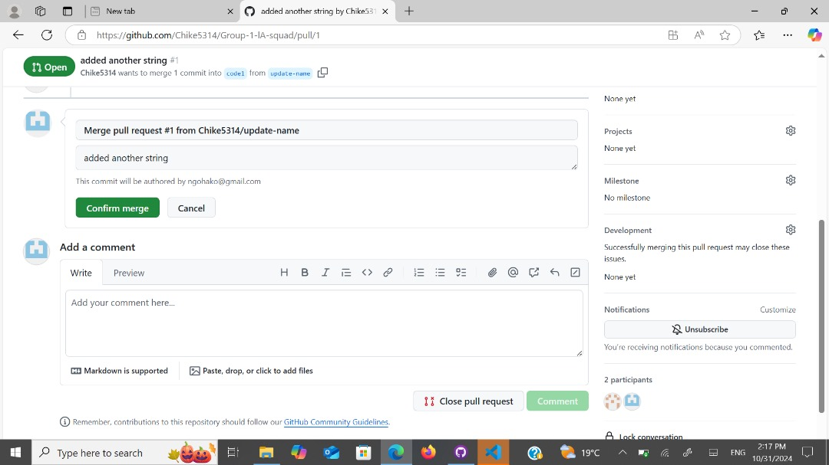
And finally merged

Slide 21
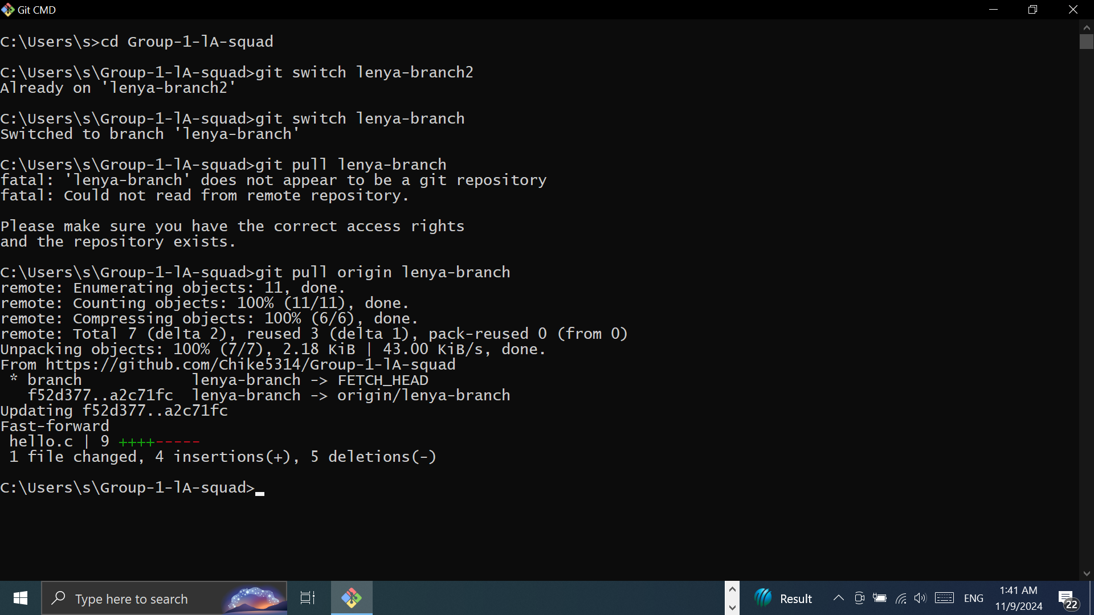
Collaborating with others
In case, some members of the team were to work on a particular feature, that is , they shared the same branch, the latest changes to that branch can be updated on my branch by pulling

